Slide 1
Fundamental Programming in JAVA
Polymorphism

Slide 2
Objectives
To discover polymorphism.
To distinguish between static and dynamic binding.
To describe casting and explain why explicit casting (down casting) is necessary.
To demonstrate Polymorphism and casting using an example
To explore the equals method in the Object class.

Slide 3
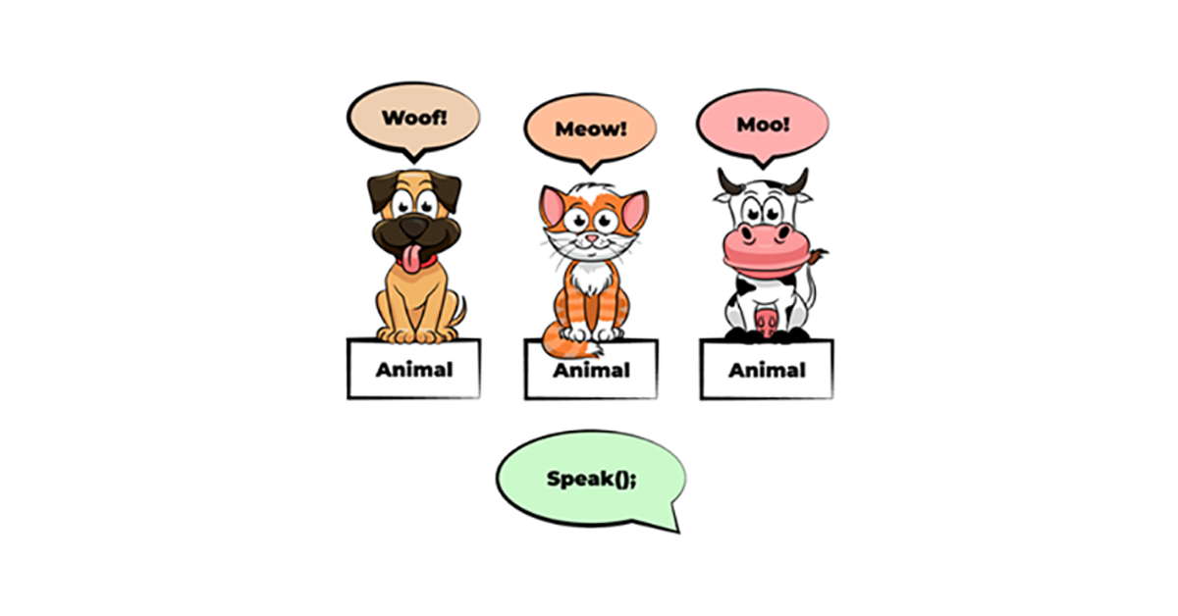
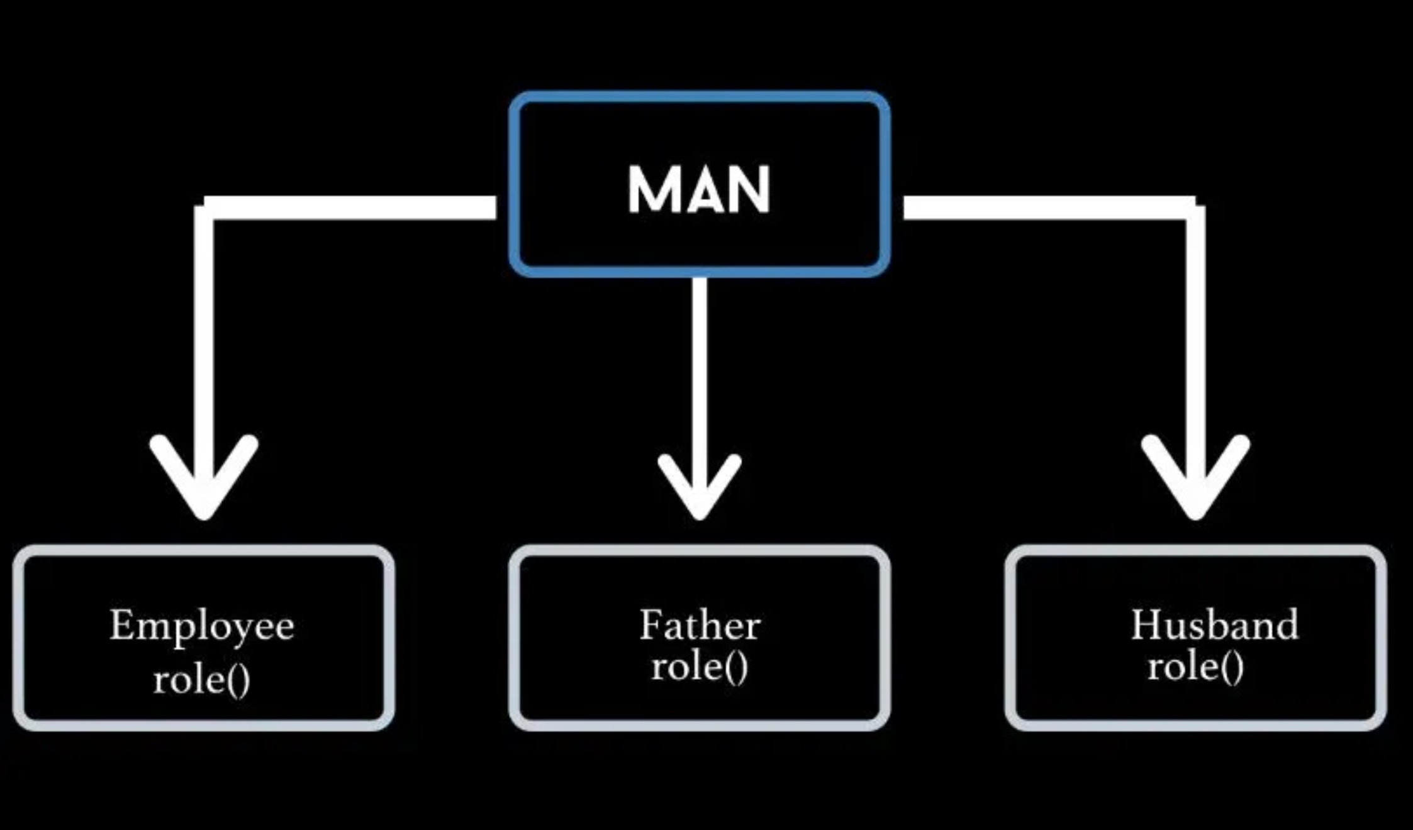
Polymorphism

Slide 4
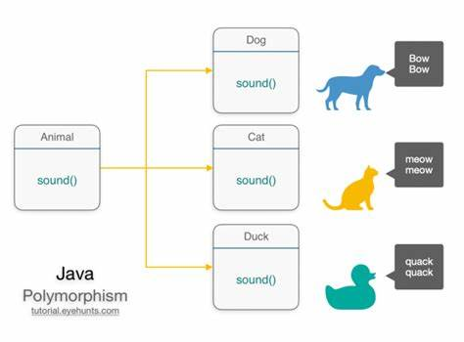
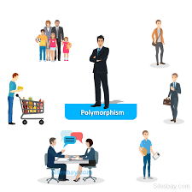
Polymorphism
Polymorphism means "many forms“. Objects are designed to share behaviors and they can take on more than one form.

Slide 5
Polymorphism in OOP
Polymorphism: Ability for the same code to be used with different types of objects and behave differently with each.
Inheritance allows you to define a base class and derive classes from the base class.
Polymorphism allows you to make changes in the method definition for the derived classes and have those changes apply to methods written in the base class.

Slide 6
Polymorphism in OOP
Polymorphism means that a variable of a supertype can refer to a subtype object.
A class defines a type. A type defined by a subclass is called a subtype, and a type defined by its superclass is called a supertype. Therefore, you can say that ElectircCar is a subtype of Car and Car is a supertype for ElectircCar.
Car
superclass
IS-A
Inheritance
ElectricCar
subclass

Slide 7
Polymorphism in OOP
Car
superclass
IS-A
Inheritance
ElectricCar
subclass
Polymorphism: Reference of supertype refer to object of subtype
Car yourCar = new ElectricCar();

Slide 8
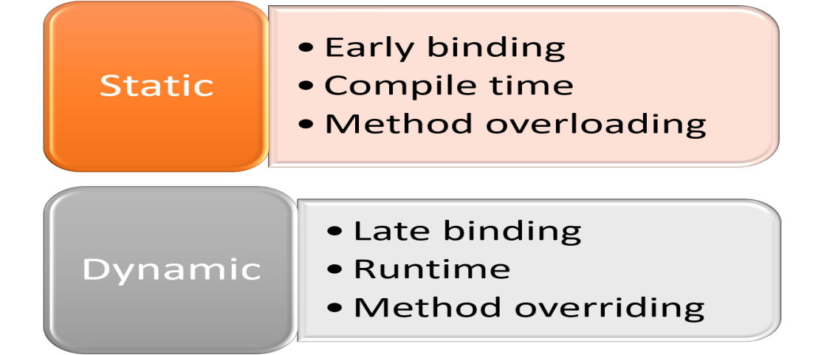
Types of Polymorphism
Polymorphism

Slide 9
Binding
Binding is what happens when a method invocation is bound to an implementation
Involves lookup of the method in the class, or one or its parents.
Both method names and parameters are checked.
Binding can happen at two different times
Compile time == static binding
Run time == dynamic binding

Slide 10
Static Binding
References have a type
i.e. they refer to instances of a particular Java class
Objects have a type
i.e. they are instances of a particular Java class
They are also instances of their super-class
Inheritance describes an IS-A relationship
e.g. an ElectricCar is a Car

Slide 11
Static Binding
Static binding done by the compiler
When it can determine the type of an object
Method calls are bound to their implementation immediately

Slide 12
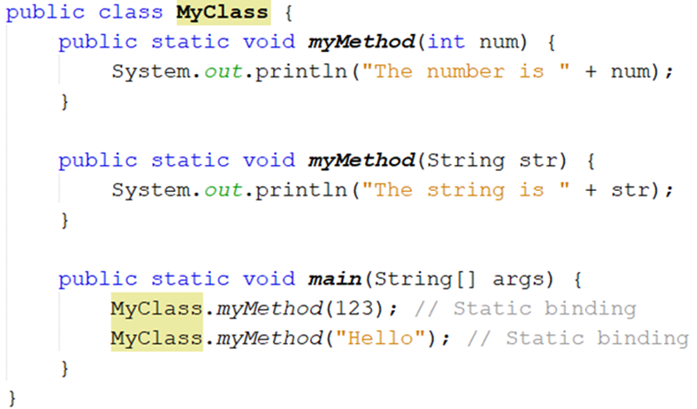
Static Binding Example 1
Method Overloading

Slide 13
Static Binding Example 2
//class definition
public class ElectricCar {
public void desBatterty()
{…}
}//usage statically bound
ElectricCar car = new ElectricCar();
car.desBatterty();

Slide 14
Static Binding Example 3
public class Car {
public void start() {…}
public void stop() {…}
}
public class ElectricCar extends Car() {
//overridden
public void start() {…}
public void desBatterty() {…}
}
//reference is to subclass
//usage still statically bound
ElectricCar myCar = new ElectricCar();
myCar.start();

Slide 15
Dynamic Binding
Java performs dynamic binding or late binding when a variable contains a polymorphic reference.
The Java Virtual Machine determines at runtime which method to call, depending on the type of object that the variable references.
Achieved at runtime
When the class of an object cannot be determined at compile time
Means the JVM (not the compiler) must bind a method call to its implementation
Instances of a subclass can be treated as if they were an instance of the superclass
Therefore the compiler doesn’t know its type, just its supertype.

Slide 16
Dynamic Binding Example 1
public class Car {
public void start() {…}
public void stop() {…}
}public class ElectricCar extends Car() {
//overridden
public void start() {…}
public void desBatterty() {…}
}
//reference is to superclass
// object is subclass
//method is dynamically bound to ElectricCar start method
Car yourCar = new ElectricCar();
yourCar.start();

Slide 17
Dynamic Binding
Dynamic binding works as follows:
Suppose an object obj is an instance of classes C₁, C₂, ..., C_{n-1}, and C_{n}, where C₁ is a subclass of C₂, C₂ is a subclass of C₃, ..., and C_{n-1} is a subclass of C_{n}.
That is, C_{n} is the most general class (Object Class), and C₁ is the most specific class.

Slide 18
Dynamic Binding
Dynamic binding works as follows:
In Java, C_{n} is the Object class. If obj invokes a method p, the JVM searches the implementation for the method p in C₁, C₂, ..., C_{n-1} and C_{n}, in this order, until it is found.
Once an implementation is found, the search stops and the first-found implementation is invoked.

Slide 19
Dynamic Binding Example 2
//remember all classes derive from Object Class
Object Obj = new ElectricCar();
Obj.toString();

Slide 20
Benefits of Polymorphism
Generic Programming: Polymorphism allows methods to be used generically for a wide range of object arguments. This is known as generic programming.
If a method’s parameter type is a superclass (e.g., Object), you may pass an object to this method of any of the parameter’s subclasses (e.g., Student or String).
When an object (e.g., a Student object or a String object) is used in the method, the particular implementation of the method of the object that is invoked (e.g., toString) is determined dynamically.

Slide 21
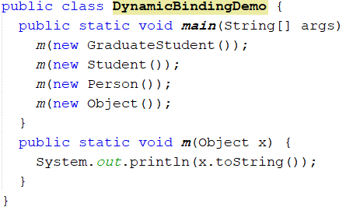
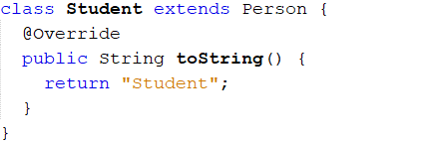

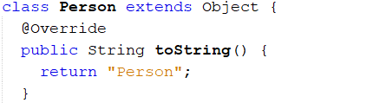

Generic Programming (Generic Method)
Output

Slide 22
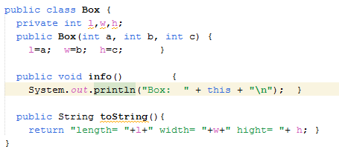
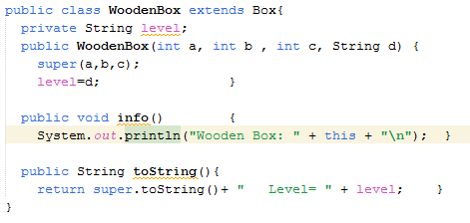
Generic Programming (Generic Array)

Slide 23
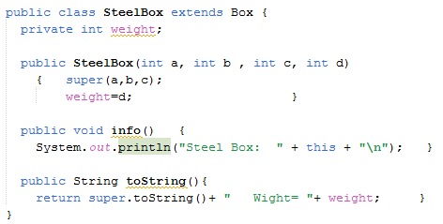
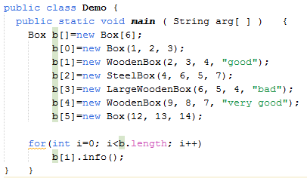
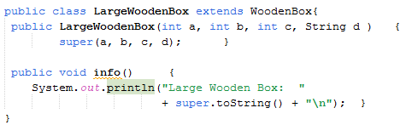
Generic Programming (Generic Array)

Slide 24
Checking an Object Type
Its possible to check the actual type of an object
May want to check the real type, if we’ve only got a reference to a superclass
Use the instanceof operator to test whether an object is an instance of a class.

Slide 25
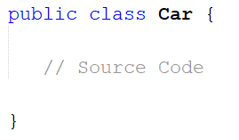
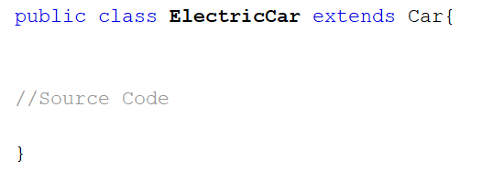
Checking an Object Type Example

Slide 26
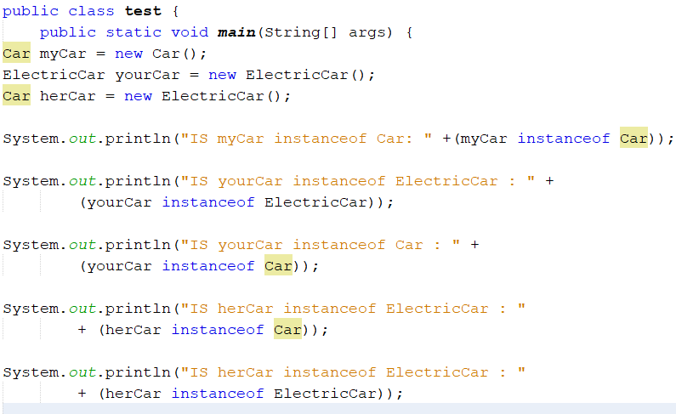
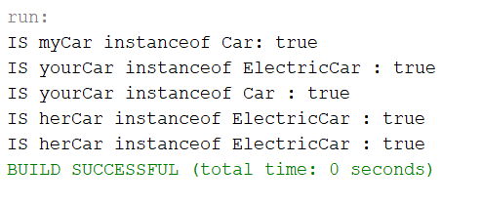
Checking an Object Type Example

Slide 27
Implicit Casting
The casting operator already used to convert variables of one primitive type to another.
Casting can also be used to convert an object of one class type to another within an inheritance hierarchy.
Object obj = new Student(); // Implicit casting

Slide 28
Implicit Casting
The casting operator already used to convert variables of one primitive type to another.
Casting can also be used to convert an object of one class type to another within an inheritance hierarchy.
The statement Object obj = new Student(), known as implicit casting, is legal because an instance of Student is automatically an instance of Object
Object obj = new Student(); // Implicit casting

Slide 29

Explicit casting
Suppose you want to assign the object reference obj to a variable of the Student type using the following statement:
A compile error would occur.
Why does the statement
Object obj = new Student() work
and the statement Student b = obj doesn’t?
Student b = obj;
This is because a Student object is always an instance of Object, but an Object is not necessarily an instance of Student. Even though you can see that obj is really a Student object, the compiler is not so clever to know it.

Slide 30
Explicit casting
To tell the compiler that obj is a Student object, use an explicit casting. The syntax is similar to the one used for casting among primitive data types. Enclose the target object type in parentheses and place it before the object to be cast, as follows:
Student b = (Student)obj; // Explicit casting
// Down casting

Slide 31
Explicit casting
If we know the type, we can then “cast” the object
If the object isn’t of that type, then an exception will be thrown
Good idea to always check before casting, unless you’re absolutely sure!
Car myCar = new ElectricCar();
if (mayCar instanceof ElectricCar) {
ElectricCar xCar = (ElectricCar)myCar;
}

Slide 32
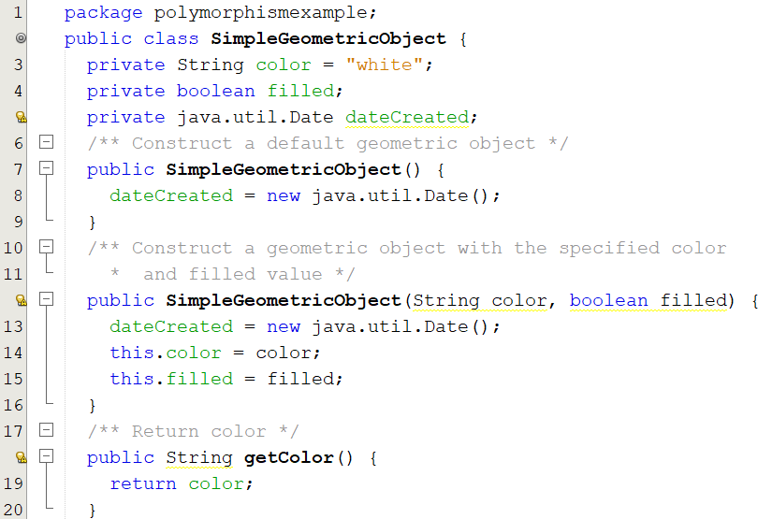
Example: Demonstrating Polymorphism and Casting
This example creates two geometric objects: a circle, and a rectangle, invokes the displayGeometricObject method to display the objects. The displayGeometricObject displays the area and diameter if the object is a circle, and displays area if the object is a rectangle.

Slide 33
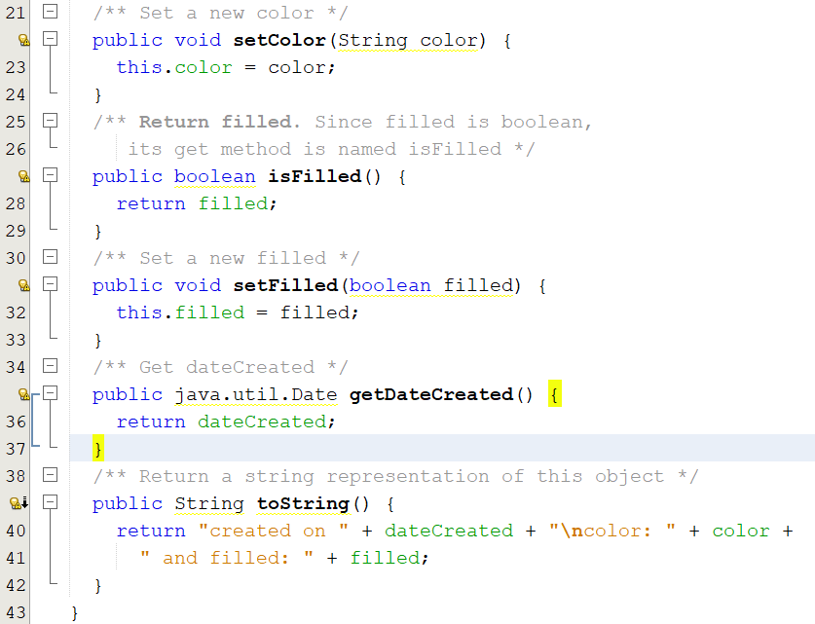
Example: Demonstrating Polymorphism and Casting(cont)

Slide 34
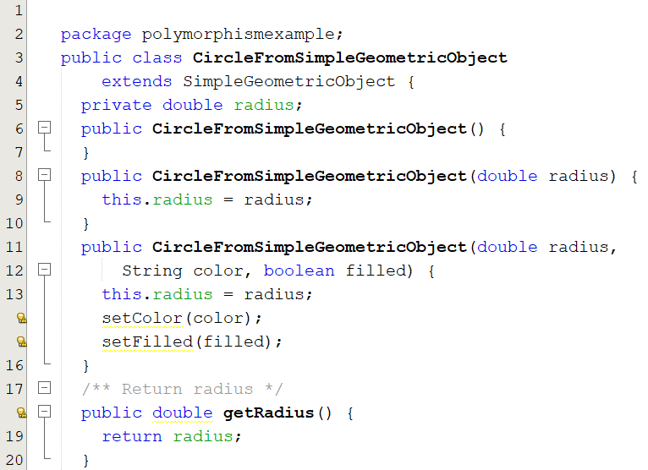
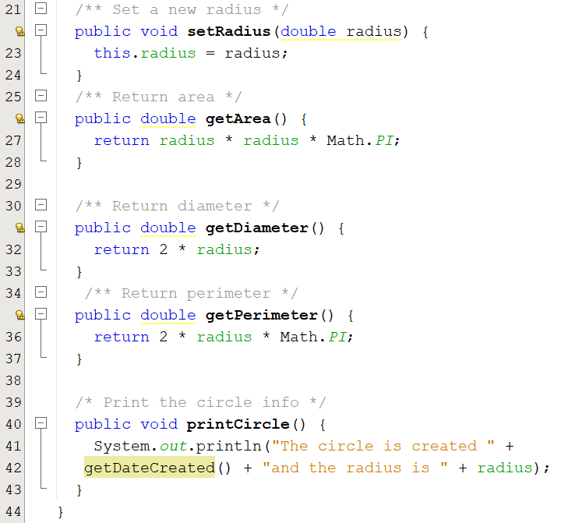
Example: Demonstrating Polymorphism and Casting(cont)

Slide 35
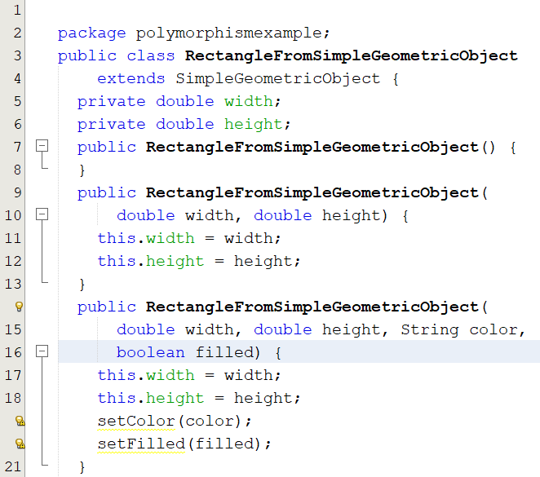
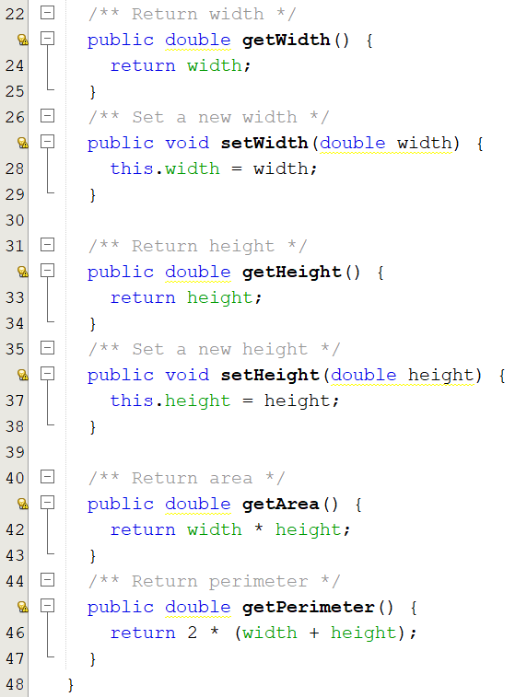
Example: Demonstrating Polymorphism and Casting(cont)

Slide 36
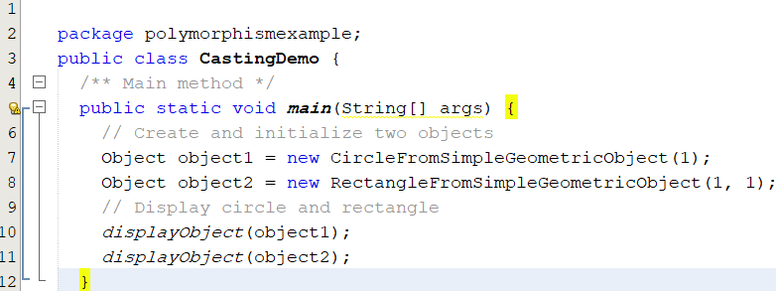
Example: Demonstrating Polymorphism and Casting(cont)

Slide 37
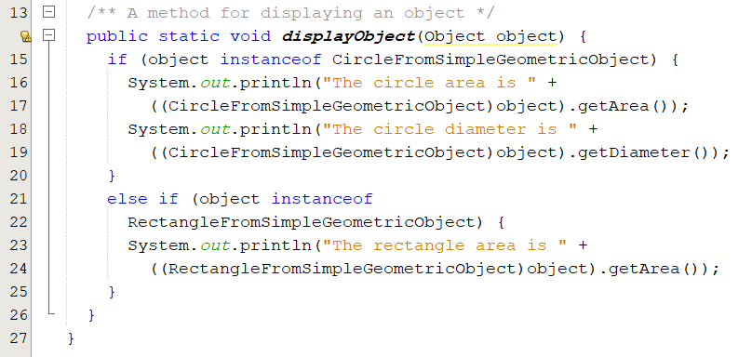
Example: Demonstrating Polymorphism and Casting(cont)

Slide 38
The equals Method
The equals() method compares the contents of two objects. The default implementation of the equals method in the Object class is as follows:
public boolean equals(Object obj) {
return this == obj;
}

Slide 39
The equals Method
For example, the equals method is overridden in the Circle class.
public boolean equals(Object o) {
if (o instanceof Circle) {
return radius == ((Circle)o).radius;
}
else
return false;
}

Slide 40
NOTE
The == comparison operator is used for comparing two primitive data type values or for determining whether two objects have the same references. The equals method is intended to test whether two objects have the same contents, provided that the method is modified in the defining class of the objects. The == operator is stronger than the equals method, in that the == operator checks whether the two reference variables refer to the same object.

Slide 41
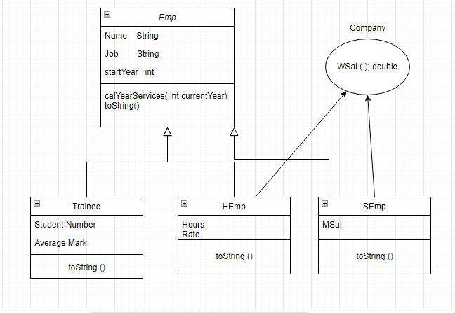
Example
Example: Going back to the company that has two types of employees, the first type gets a monthly salary (SEmp), and the other gets an hourly-based salary (HEmp). This company also employs (Trainee) who work for experience only and receive no pay from the employer.

Slide 42
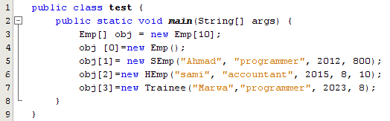
Example
In the main class, define an array that can hold any type of employee and go through them to call each method in every class (i.e. calYearServices (int currentYear), toString(), and Wsal())
Now, Can we define one array that can hold objects from SEmp and HEmp at the same time? Yes. Define an array of Emp:

Slide 43
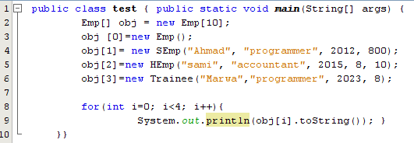
Example(cont)
You have undoubtedly noticed that some methods, like calYearServices (int currentYear) and toString()), exist in both the superclass and the subclasses, while others, like Wsal(), only exist in the subclasses. Let's demonstrate how these two situations should be handled when the loop statement is used.
First situation (Method exist in both the superclass and the subclasses):
Note that The statement that is shown in line 9 will not generate a compilation time error. That is because obj is of the Emp type, and Emp defines the toString method.

Slide 44
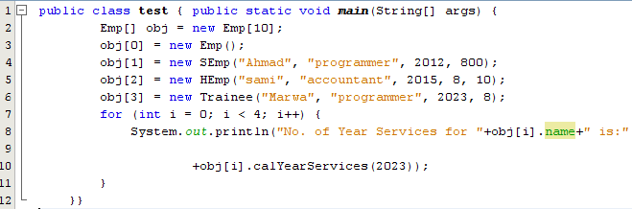
Example(cont)
Now let’s call calYearServices(int currentyear) for each method in every class.

Slide 45
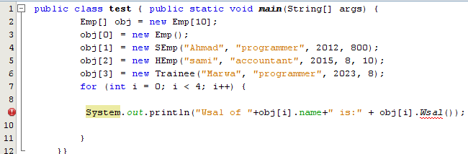
Example(cont)
Second situation (Method only exist in the subclasses):
Note that The statement that is shown in line 9 will (); will generate compilation error, since obj is of type Emp, and Emp didn’t define this method.
We can’t compute the total salaries directly, as we did with abstract classes; this is because WSal() is not defined in the superclass (the array type).
Okay, we should use casting in order to bypass the error, but should we cast obj[i] to SEmp or Hemp?See the next slide to determine to whom we should cast obj [i])

Slide 46
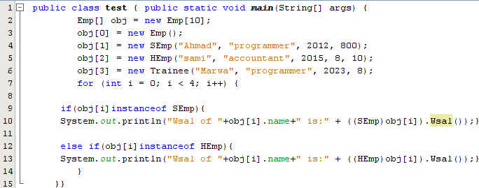
Example(cont)
In this example, we just check if obj[i] is an instance of a SEmp or HEmp. Why?
Answer: Obj [i] might also be Emp or Trainee, isn't it? and you probably know that neither of them defines this method (Wsal).

Slide 47
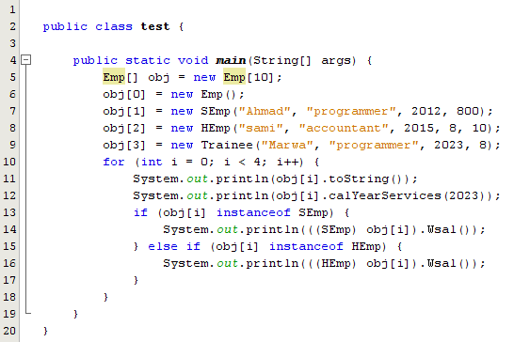
Example(cont)

Slide 48
References
Introduction to Java Programming, Comprehensive Version, Student Value Edition, Daniel Liang, 12th Edition, Pearson 2019
lecture Notes: edugate.asu.edu.jo.
lecture Videos: YouTube channel.
How to install JDK & NetBeans IDE manual.

